Slide 1
Modeling Crime in Los Angeles
Julia McNerney, Yue Wan & Xukan Zhang ACMS40842

Slide 2
Background
Los Angeles ranks 17th in crime rate for US cities with population >100,000
- Highest among the biggest cities in the US (NYC, Chicago, Houston, Phoenix, Philadelphia)
3rd largest police department in US
- $1.74 billion budge
- $420 per resident
One of the most diverse cities in the US
- 50% latino, 11% asian, 10% black

Slide 3
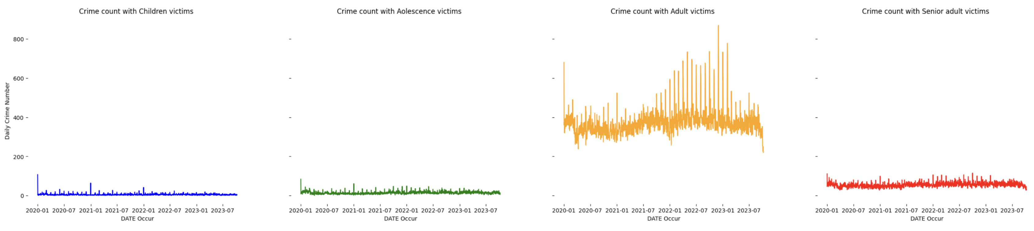
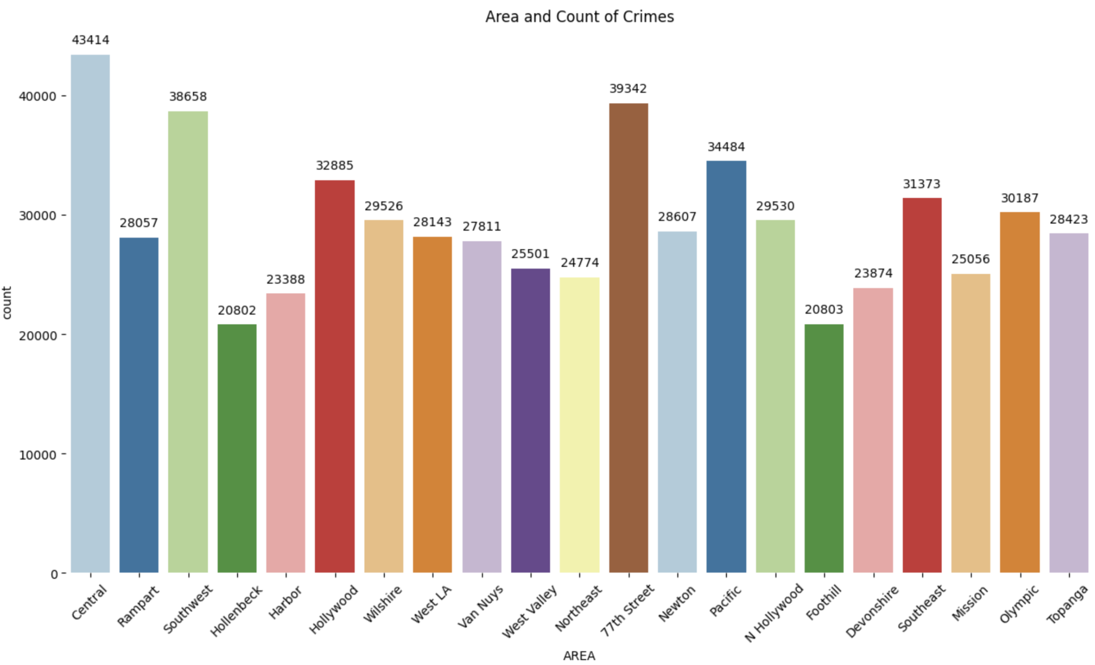
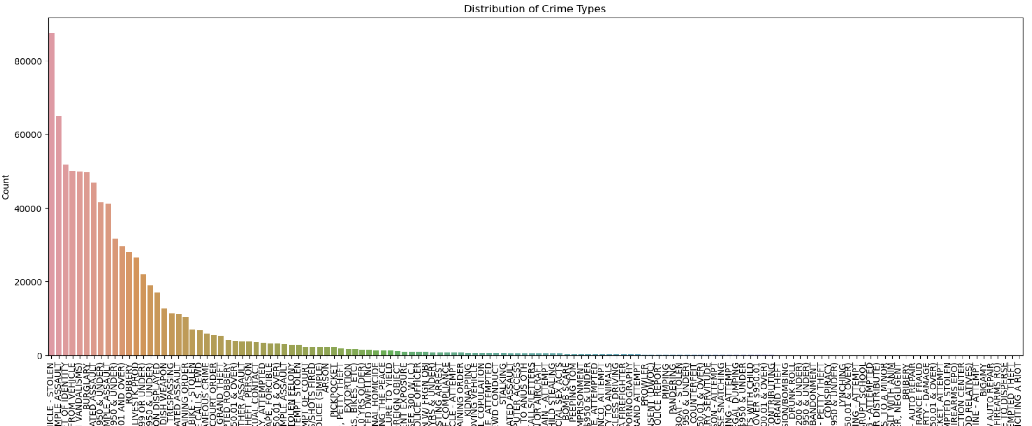
Dataset Overview: 01/01/2020 - 10/08/2023 Over 700k Crime Case
Selected Features: Area, Crime Type, Victim Sex, Age & Descent, Exact Time

Slide 4
Research Questions
Examine how crime trends differ for different groups of victims.
Enable policy makers to create more appropriate solutions to fighting crime
Deeper understanding of who is most affected by crime
Help the general public become aware of the possible crimes

Slide 5
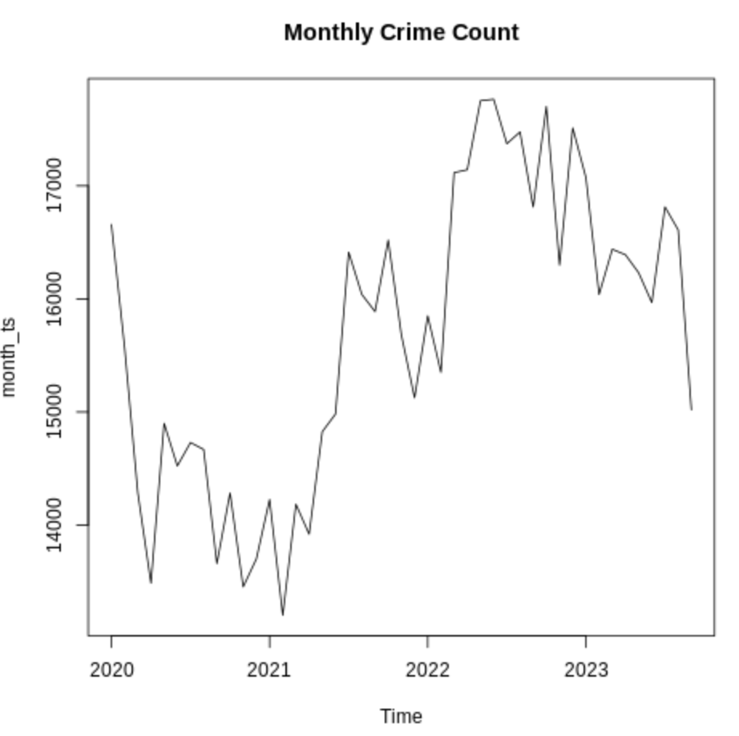
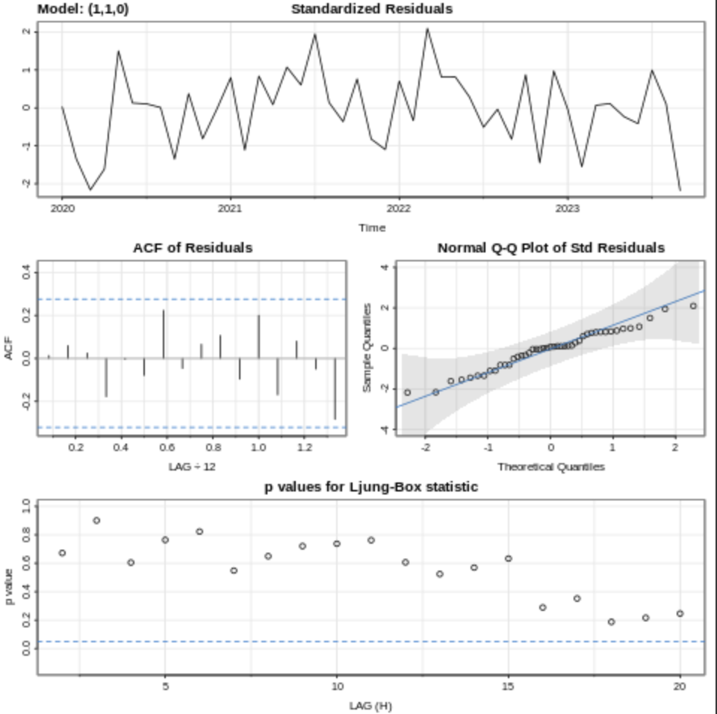
Overall crime count model (monthly)
ARIMA(1,1,0)
No seasonality

Slide 6
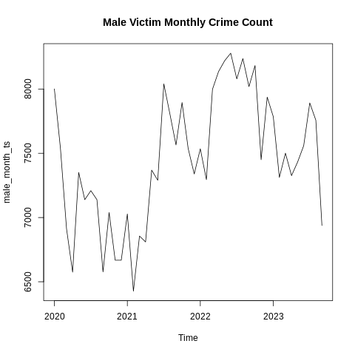
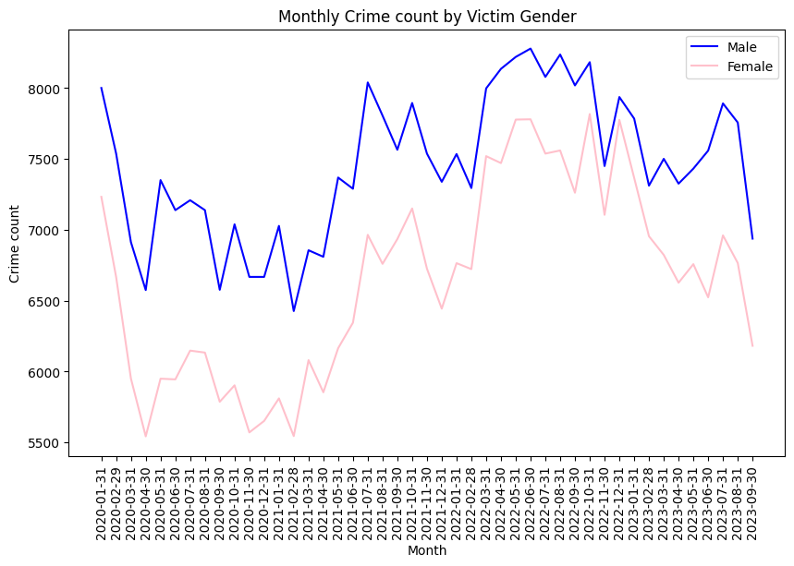
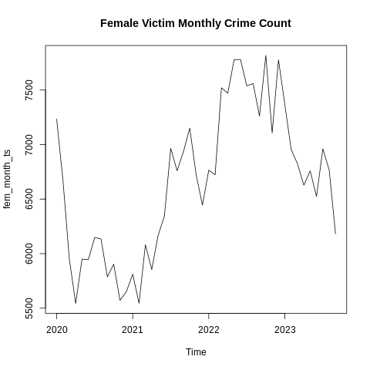
Segmented by Victims’ Gender (Monthly): EDA
Largely similar, but enough differences to explore further

Slide 7
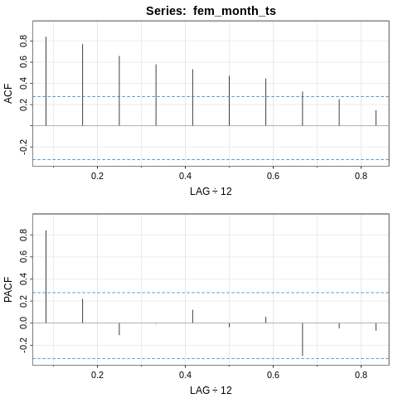
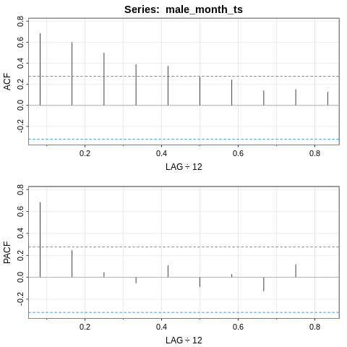
Segmented by Victims’ Gender (Monthly): EDA
Female Victims
Male Victims
Indicate AR(1) Model

Slide 8
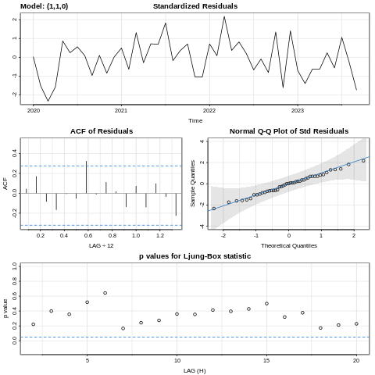
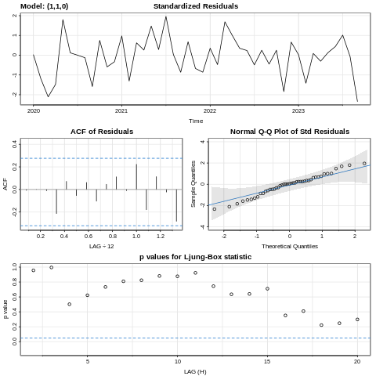
Segmented by Victims’ Gender (Monthly): Model Selection
Female Victims: ARIMA(1,1,0)
Male Victims: ARIMA(1,1,0)
All diagnostic plots look good

Slide 9
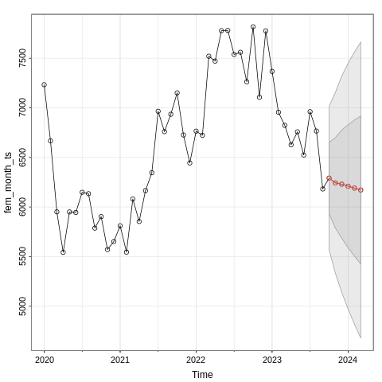
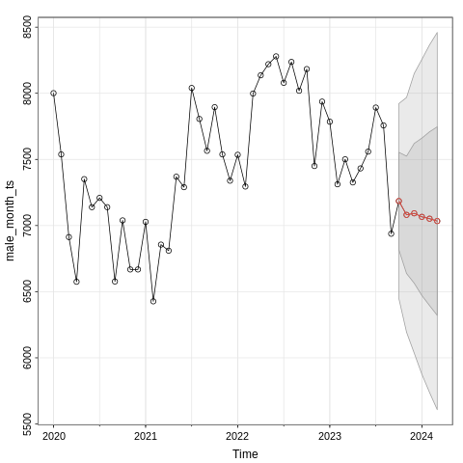
Segmented by Victims’ Gender (Monthly): Forecasting
Female Victims:
Male Victims
Decreasing prediction

Slide 10
Summary of monthly trend
No difference in crime count trends toward male and female victims
- Efforts aimed to reduce crime against males or females may be effective in reducing crime overall
- Analysis into type of crime, area, etc may be more insightful when dealing with gender of victim

Slide 11
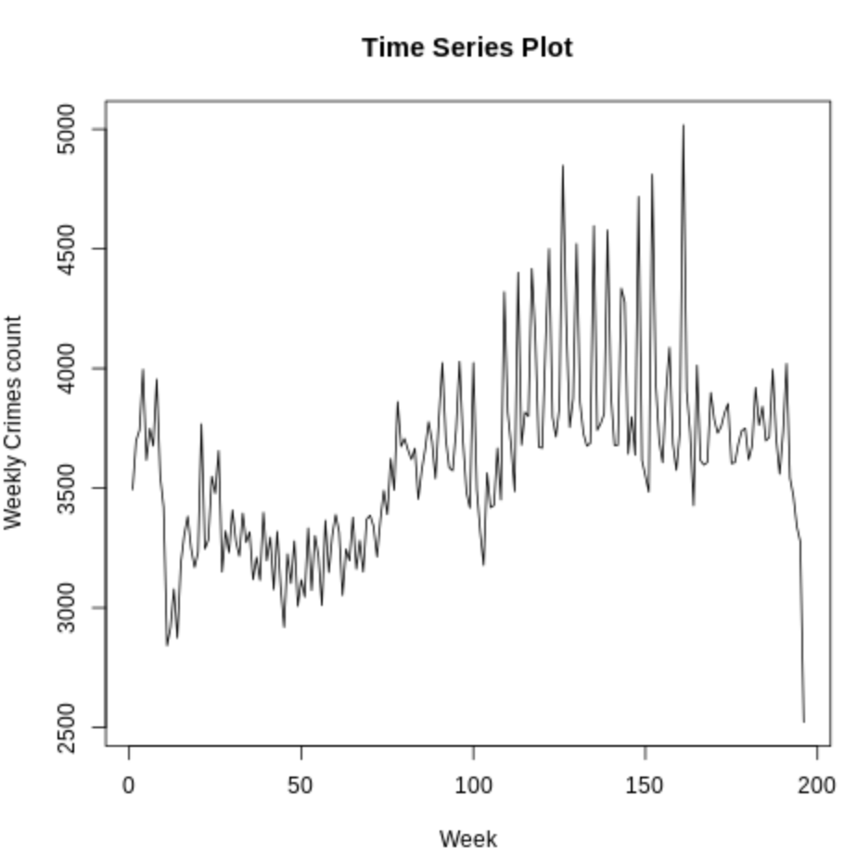
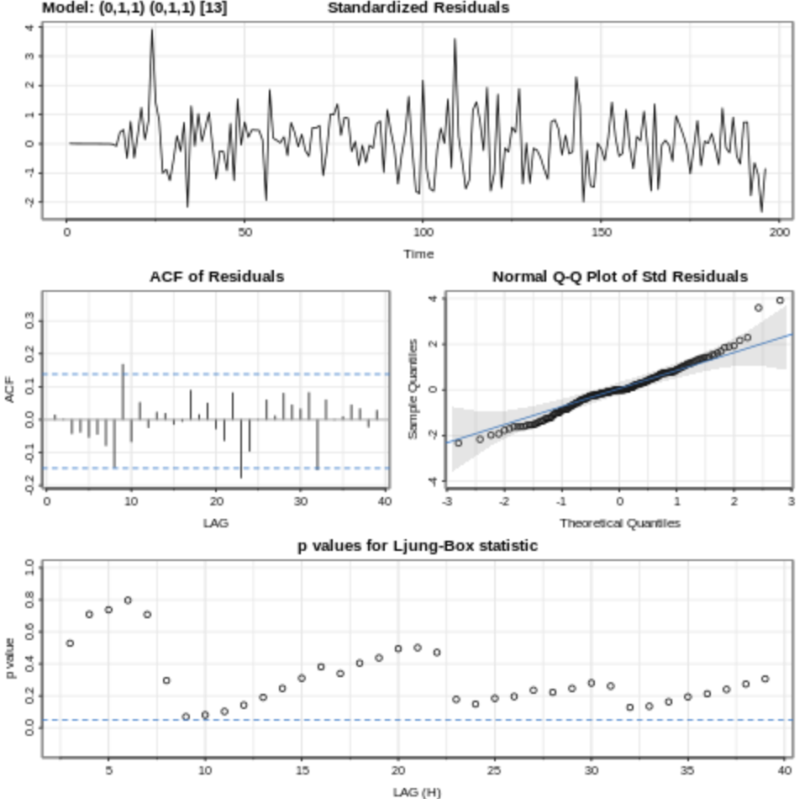
Overall crime count model (weekly)
3 months seasonality
ARIMA(0,1,1) x (0,1,1) [S=13]
01/06/2020- 10/08/2023

Slide 12
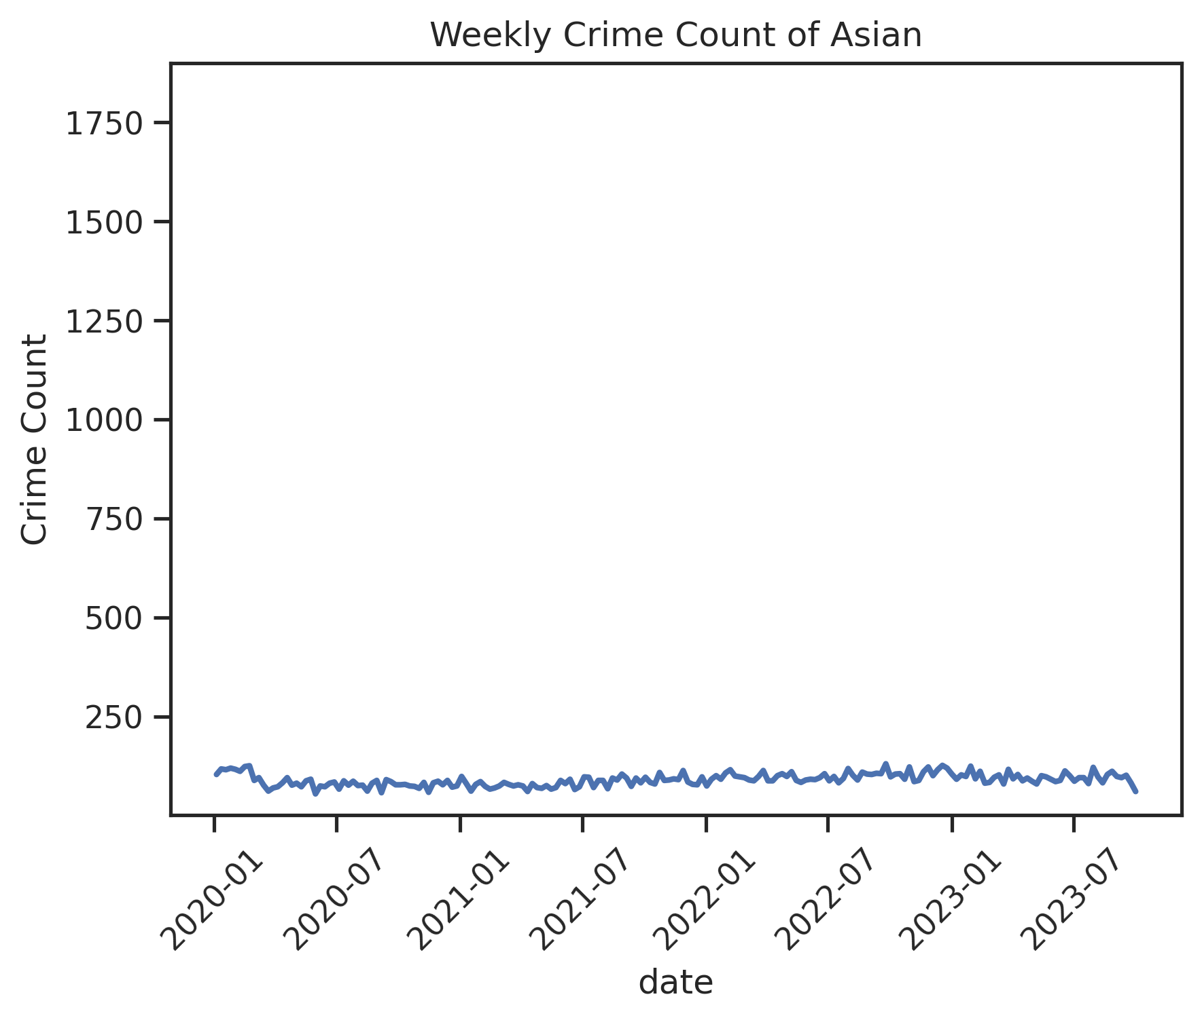
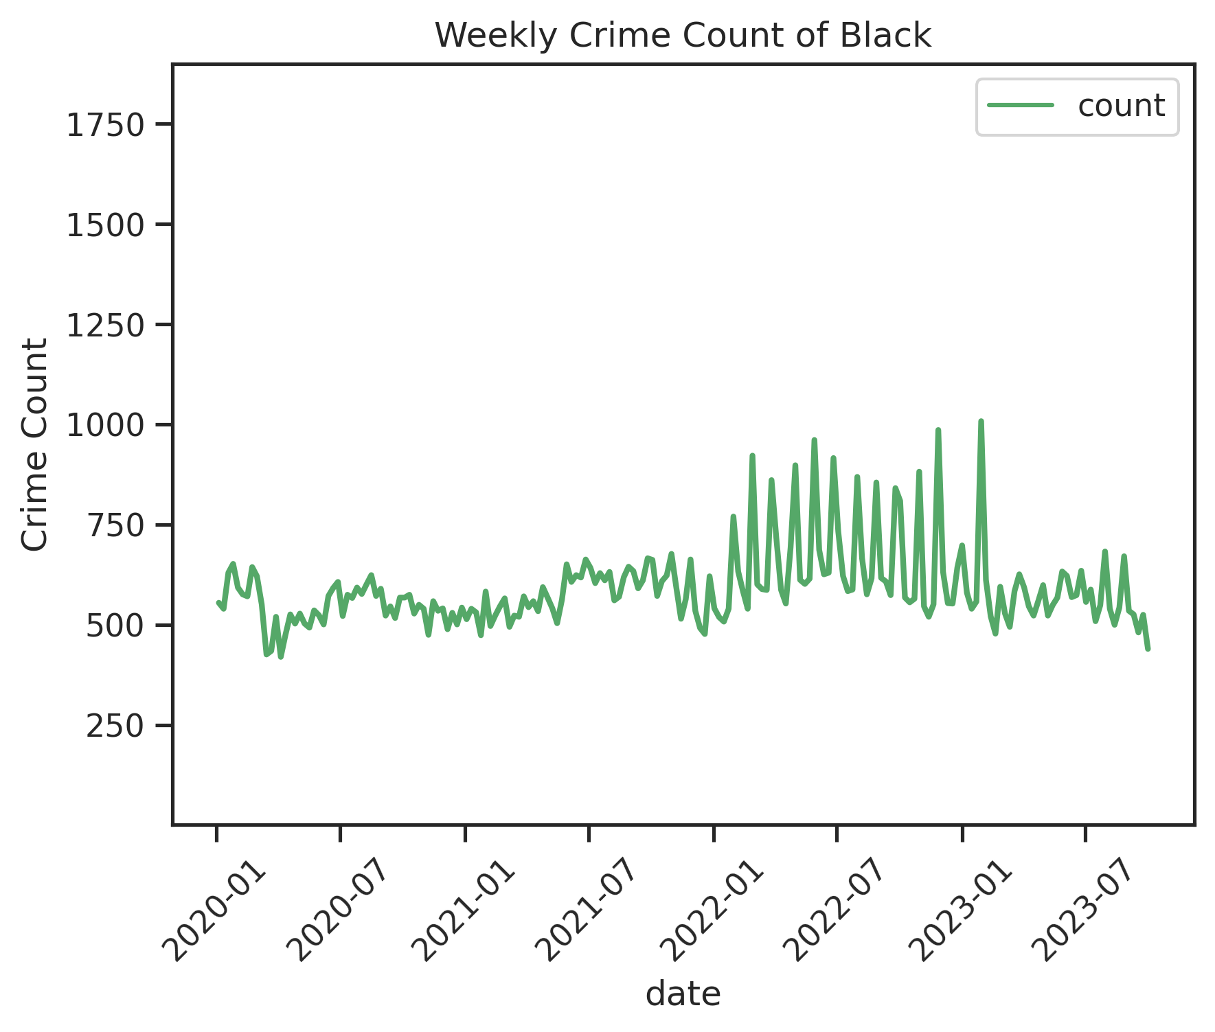
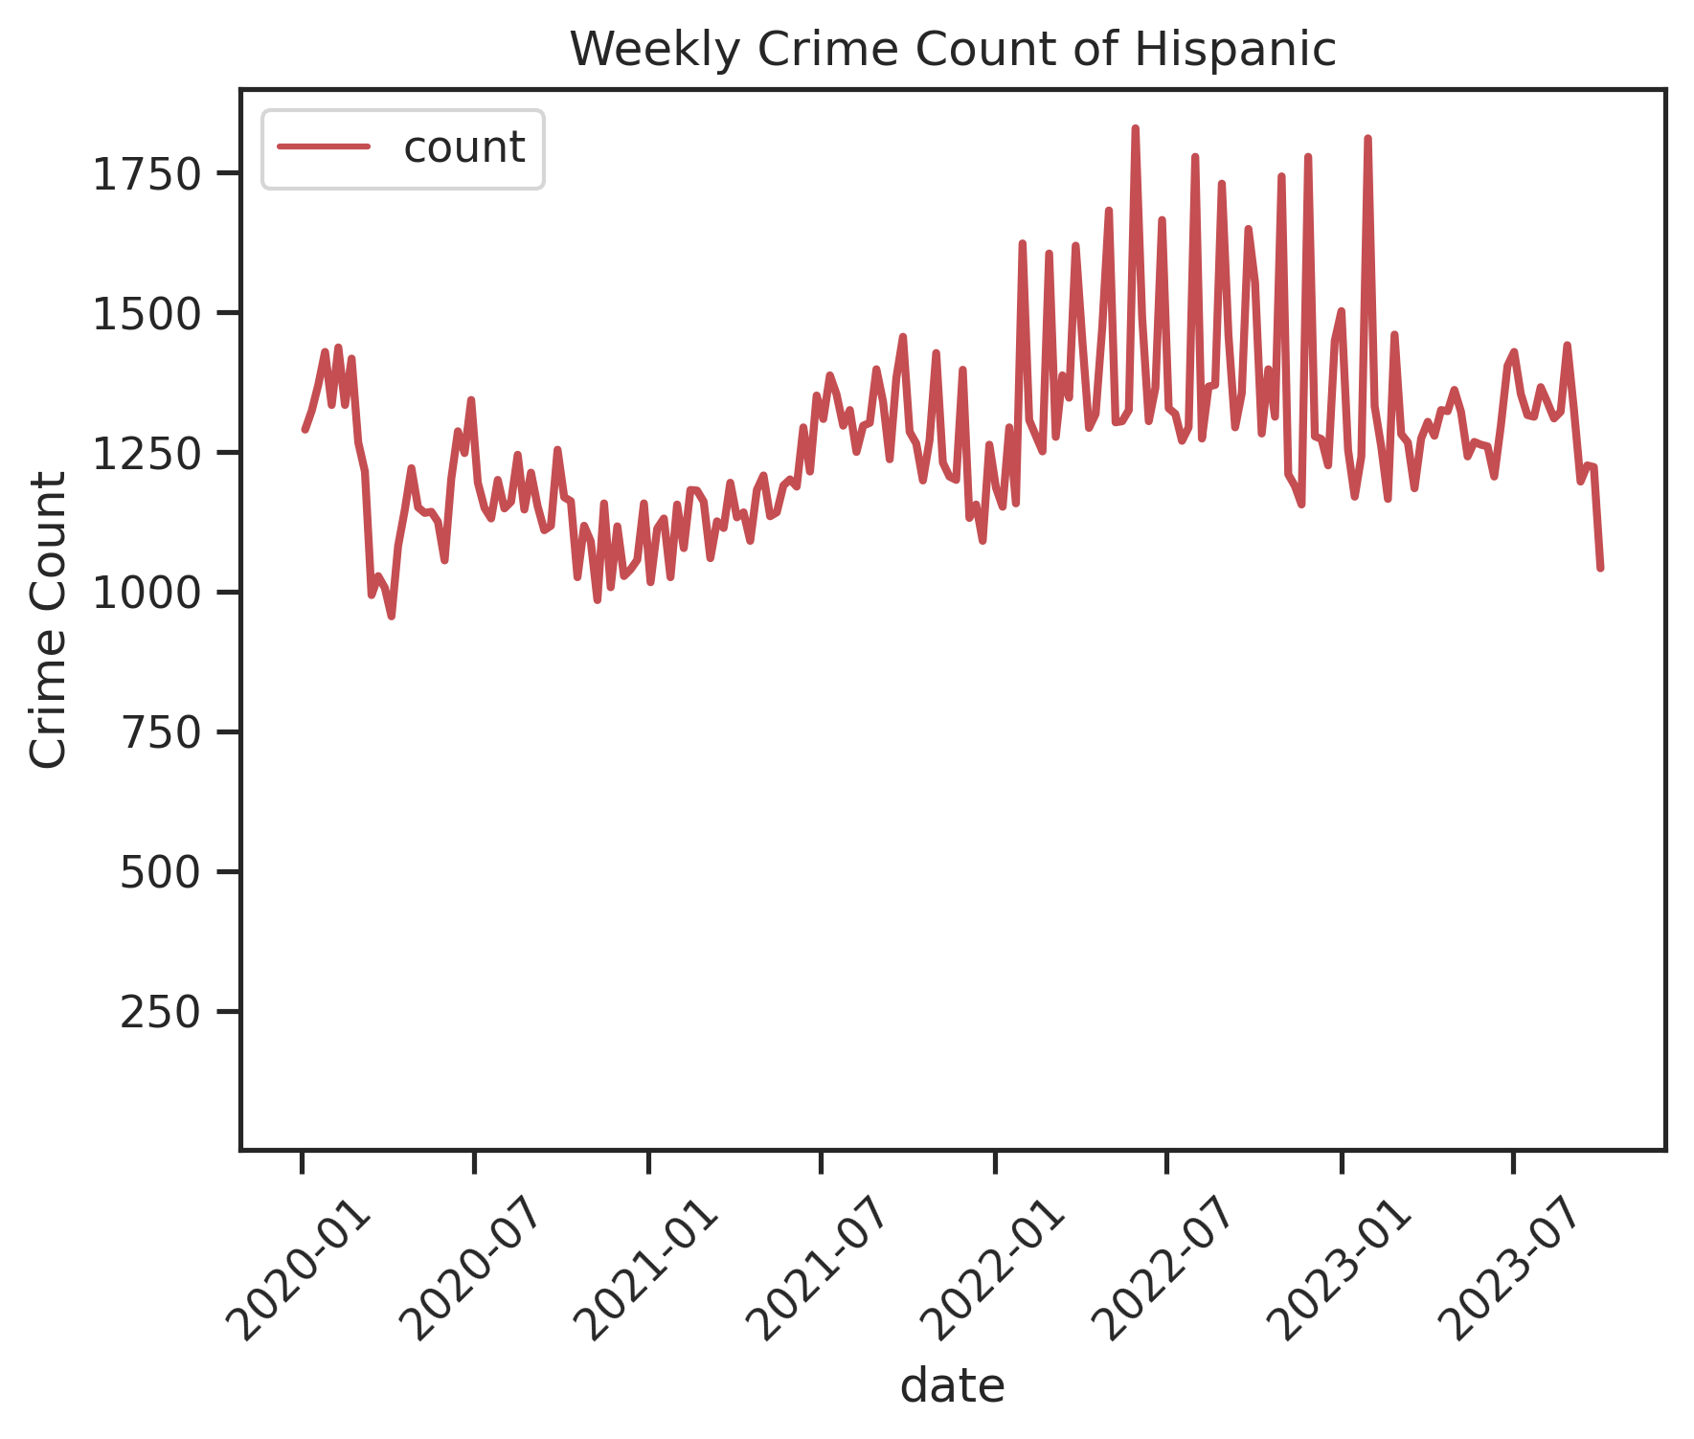
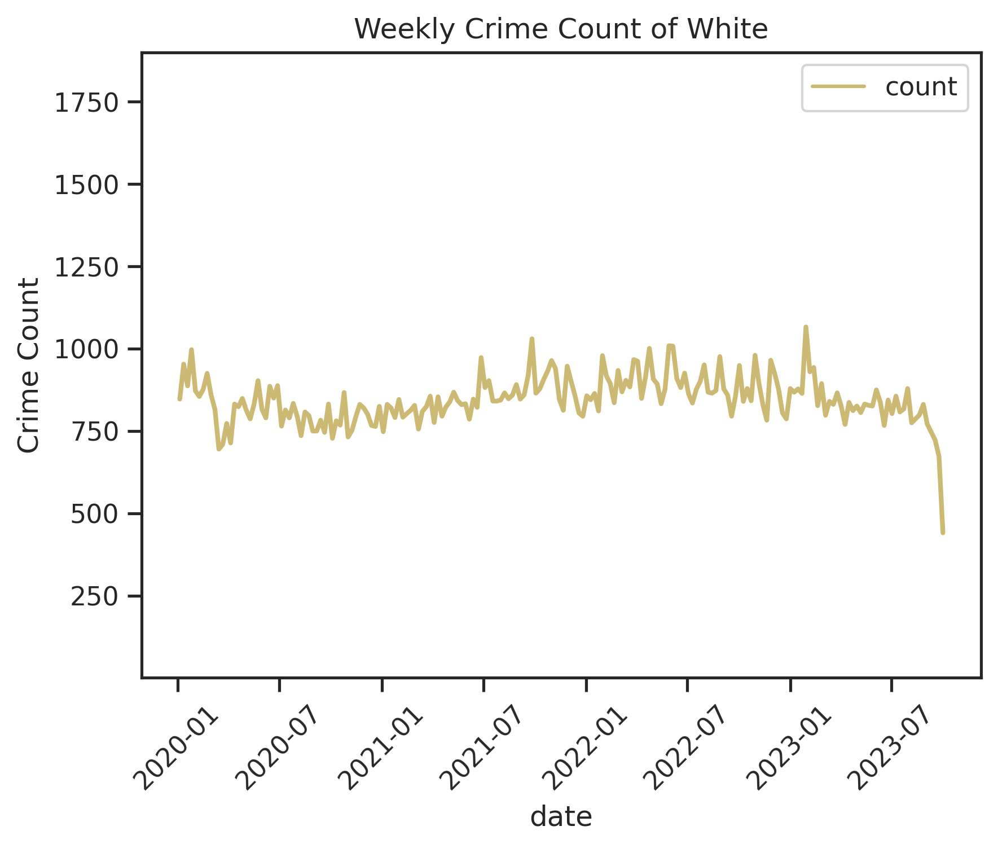
Victim Descent
Obvious differences in average counts
Possibly different trends and seasonality

Slide 13
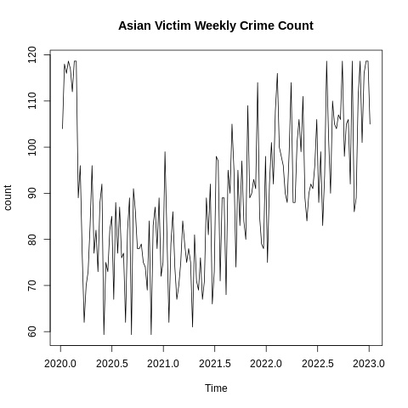
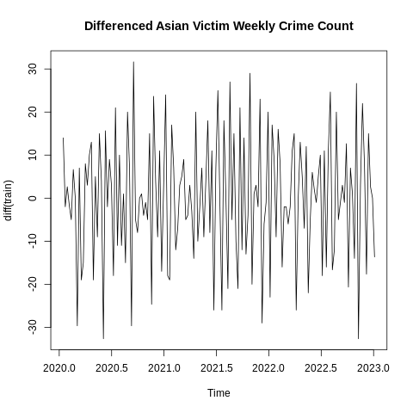
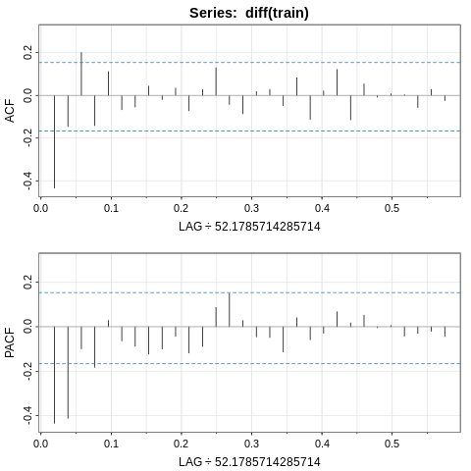
Weekly Asian Victim Crime Count
No seasonality
Possible Model: ARIMA(0,1,1)

Slide 14
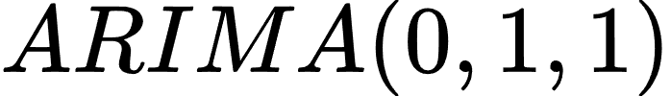
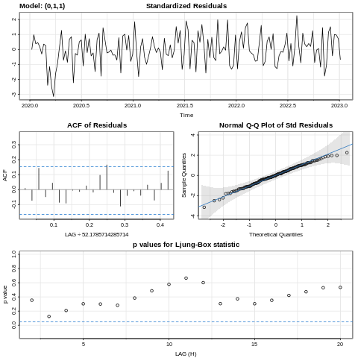
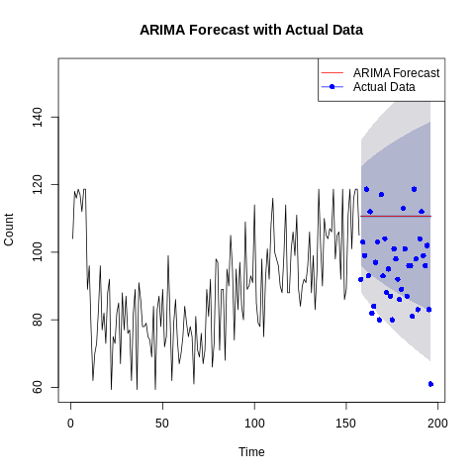
Weekly Asian Victim Crime Count
Prediction: constant trend

Slide 15
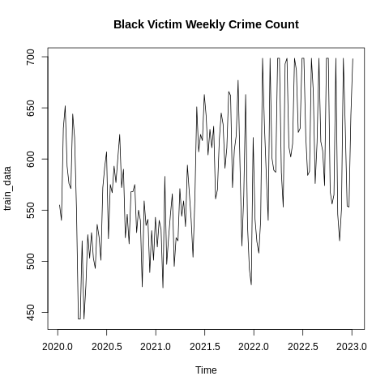
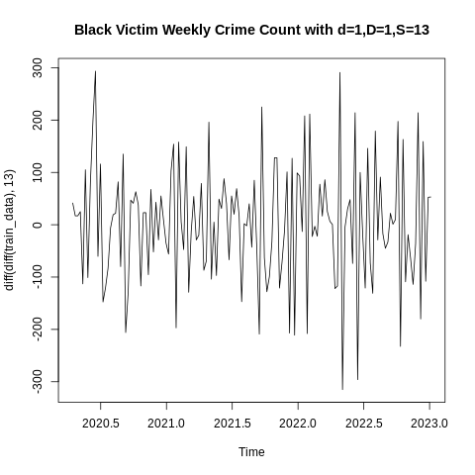
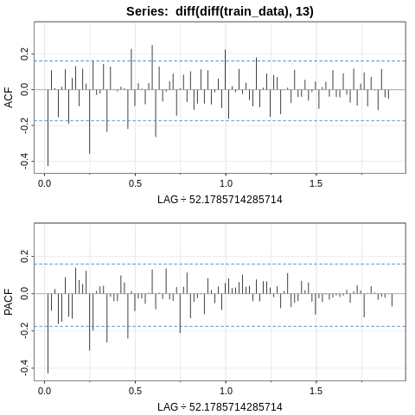
Weekly Black Victim Crime Count
Seasonality with S=13
Possible Model: MA(1), undetermined for seasonal component

Slide 16
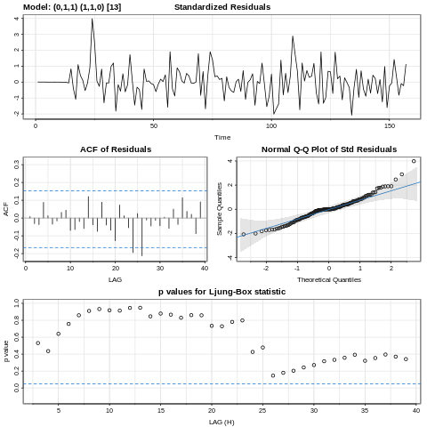
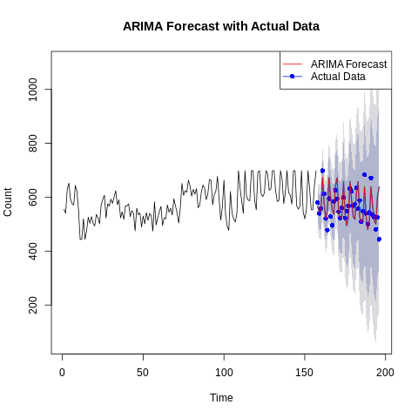
Weekly Black Victim Crime Count
Prediction:
decreasing trend with seasonality

Slide 17
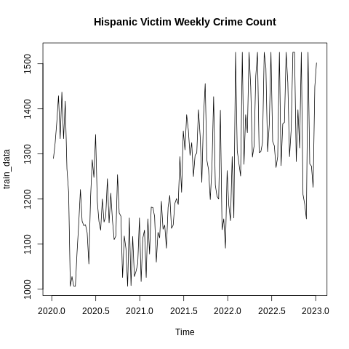
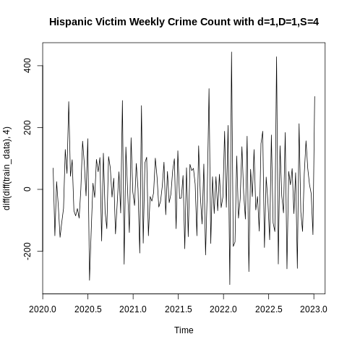
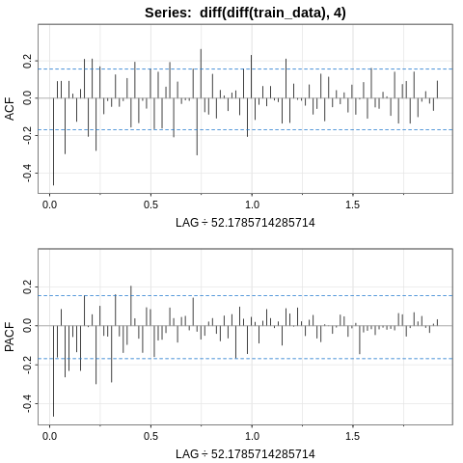
Weekly Hispanic Victim Crime Count
Seasonality with S=4
Possible Model: both seasonal and non-seasonal components cannot be determined from the ACF and PACF plot

Slide 18
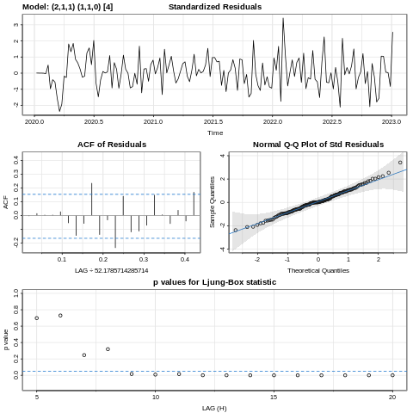
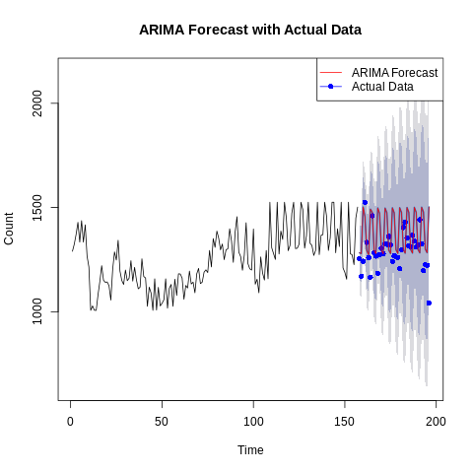
Weekly Hispanic Victim Crime Count
Prediction:
constant trend with seasonality

Slide 19
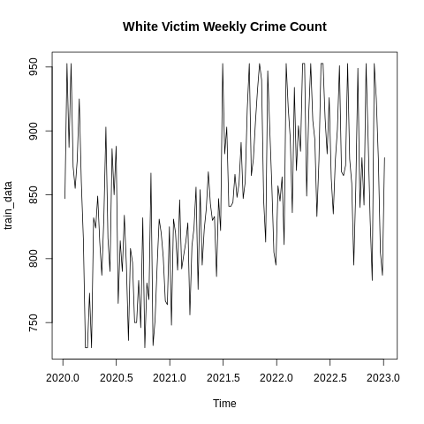
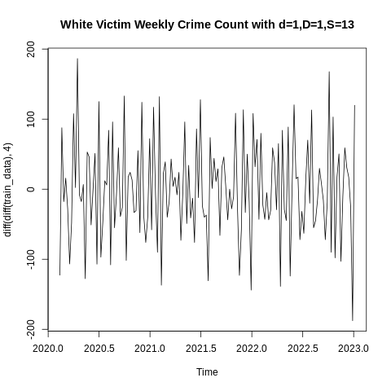
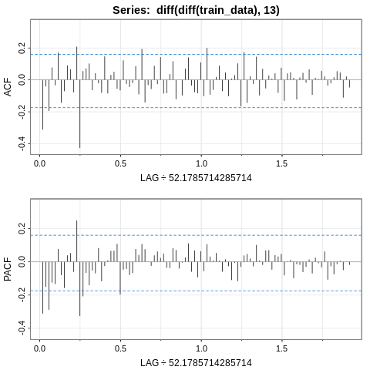
Weekly White Victim Crime Count
Seasonality with S=13
Possible Model: both seasonal and non-seasonal components cannot be determined from the ACF and PACF plot

Slide 20
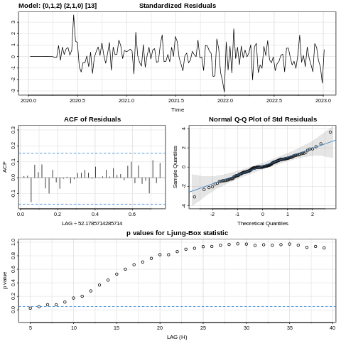
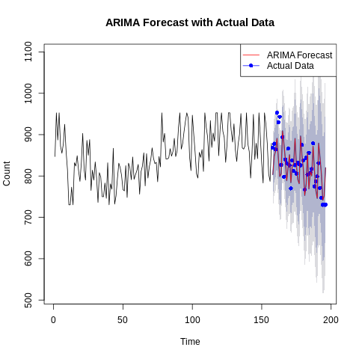
Weekly White Victim Crime Count
Prediction:
decreasing trend with seasonality

Slide 21
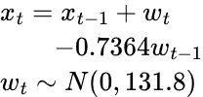
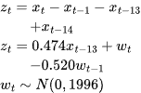
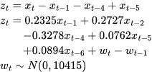
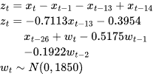
Models for different Victim Descent
Victim Descent | Asian | Black | Hispanic | White
Model Fitted
Equation of Model
39-week Prediction

Slide 22
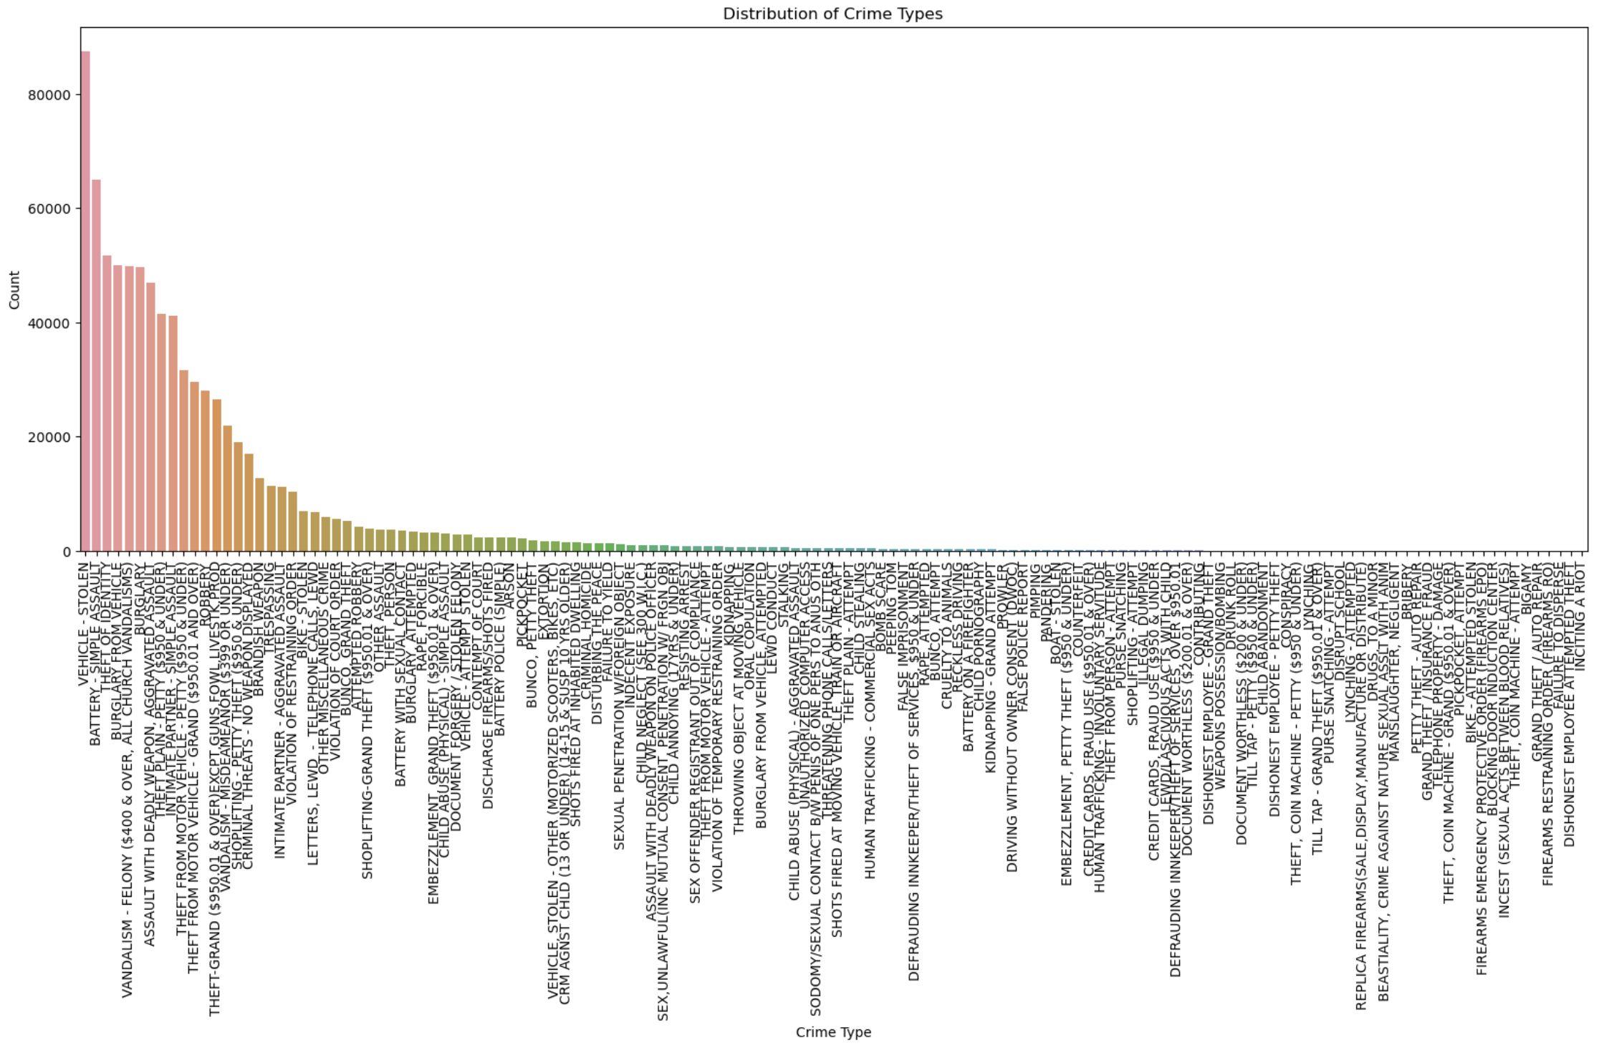
Segmented by Crime Type: EDA
210 Crime Types Overall

Slide 23
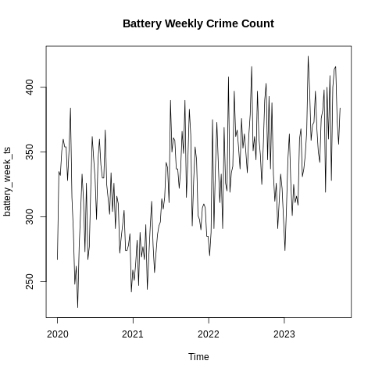
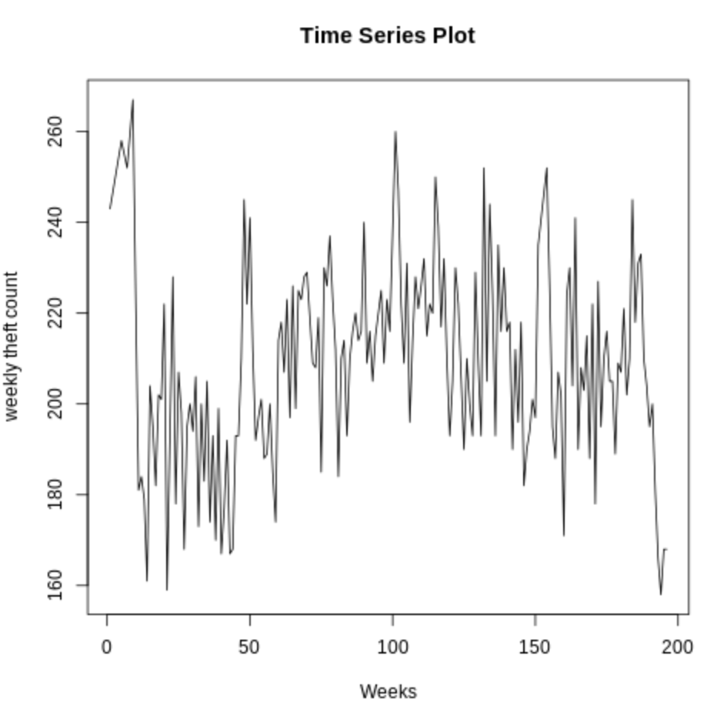
Segmented by Crime Type: EDA
Battery - Simple Assault
Theft - Plain (Under 950$)

Slide 24
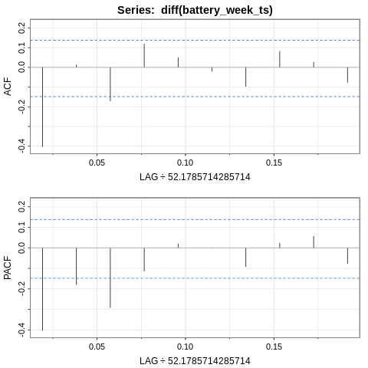
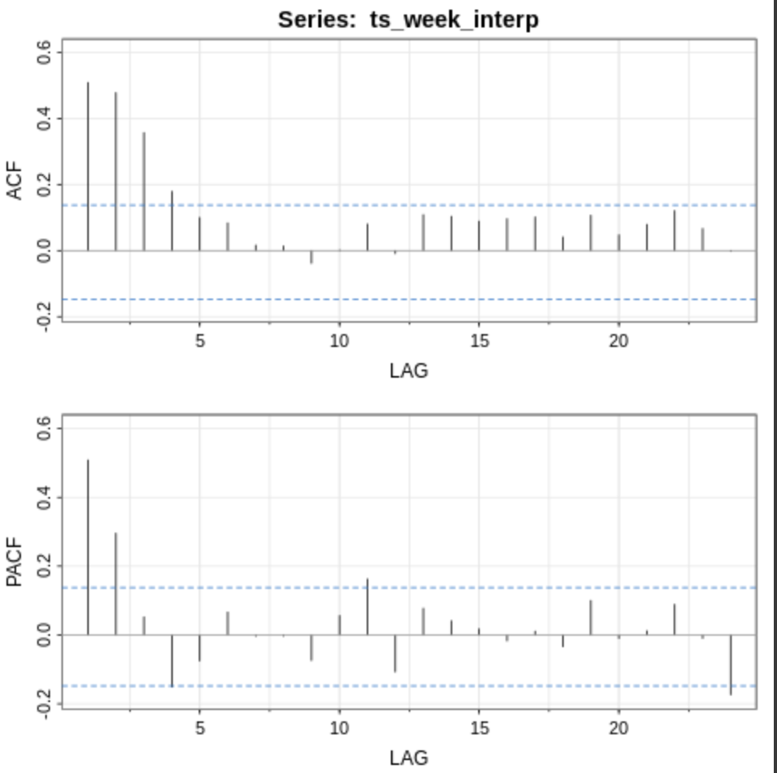
Segmented by Crime Type: EDA
Battery: possible MA(1) model
Theft：possible AR(2) model

Slide 25


Segmented by Crime Type: Model Diagnostics
Battery: ARIMA(0,1,1)
Theft: MA(2)

Slide 26


Segmented by Crime Type: Forecasting
Battery: slight increase 12 weeks ahead
Theft

Slide 27
Summary of Crime Type Trend
Difference in modeling the type of crime occurred
- ARIMA(0,1,1) vs MA(2) indicate a more complex relationship with previous theft incidents compared to battery crimes
- Measures to prevent theft may be more difficult to predict the success of compared to battery

Slide 28


Segmented crime count model EDA (hourly)
01/01/2020 - 02/29/2020
Overall Hourly Crime Count
Hourly Crime Count over 2 months

Slide 29






Segmented crime count model fitting (hourly)
Apparent Seasonality
SARIMA(1,0,1)x(0,1,1) S=24

Slide 30

Question: - Is there a relationship between victim profile and crime info?
- Instead of overall crime count trend, can we predict a future crime within one hour time precision?
Proposed Solution: RNN model (Capture Sequential Dependencies)
- Using victim’s profile (sex, age & descent) to predict crime area and type
Data Pre-processing: 700k crime => 4k crime
Rounding each crime time to the closest integer hour
Rounding each age to multiples of 5
Use mode for each feature at the same rounding hour:
Do not choose real crime, choose the most possible crime pattern

Slide 31



Training and Prediction Results
Take aways:
- Training is effective, best accuracies are good compared to untrained accuracies
Model converges quickly (within each epoch), may be due to lack of data, and model is relatively complex (500 hidden neurons)
Unbalanced class (crime type)
Future analysis and models can be developed to predict crime more precisely

Slide 32

Q&A

